Slide 1
ECO346 • ASSIGNMENT 1 PRESENTATION
Education Spending & Gender Literacy Profile
Empirical findings for Sindh Rural (Variant 2) based on PSLM survey data
REG NUMBER
GEOGRAPHY
STACK
FA24-BEDS-002
Sindh Rural (Variant 2)
R & Python

Slide 2
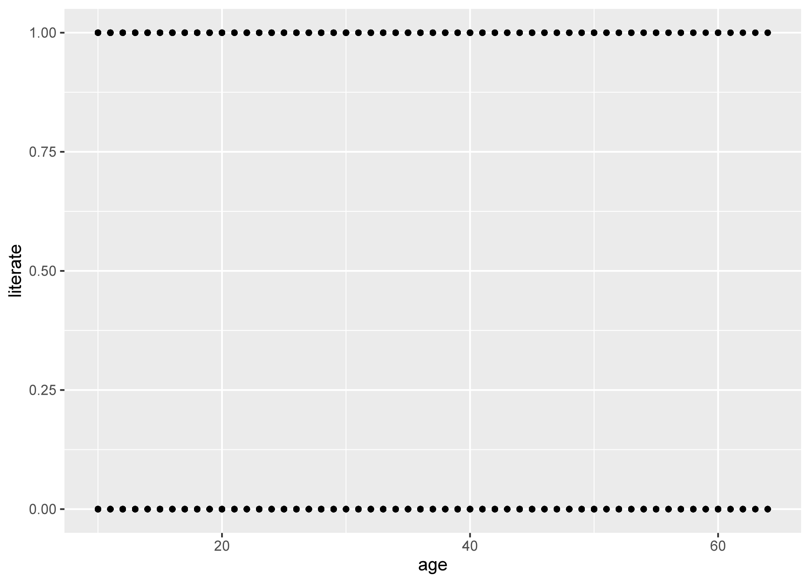
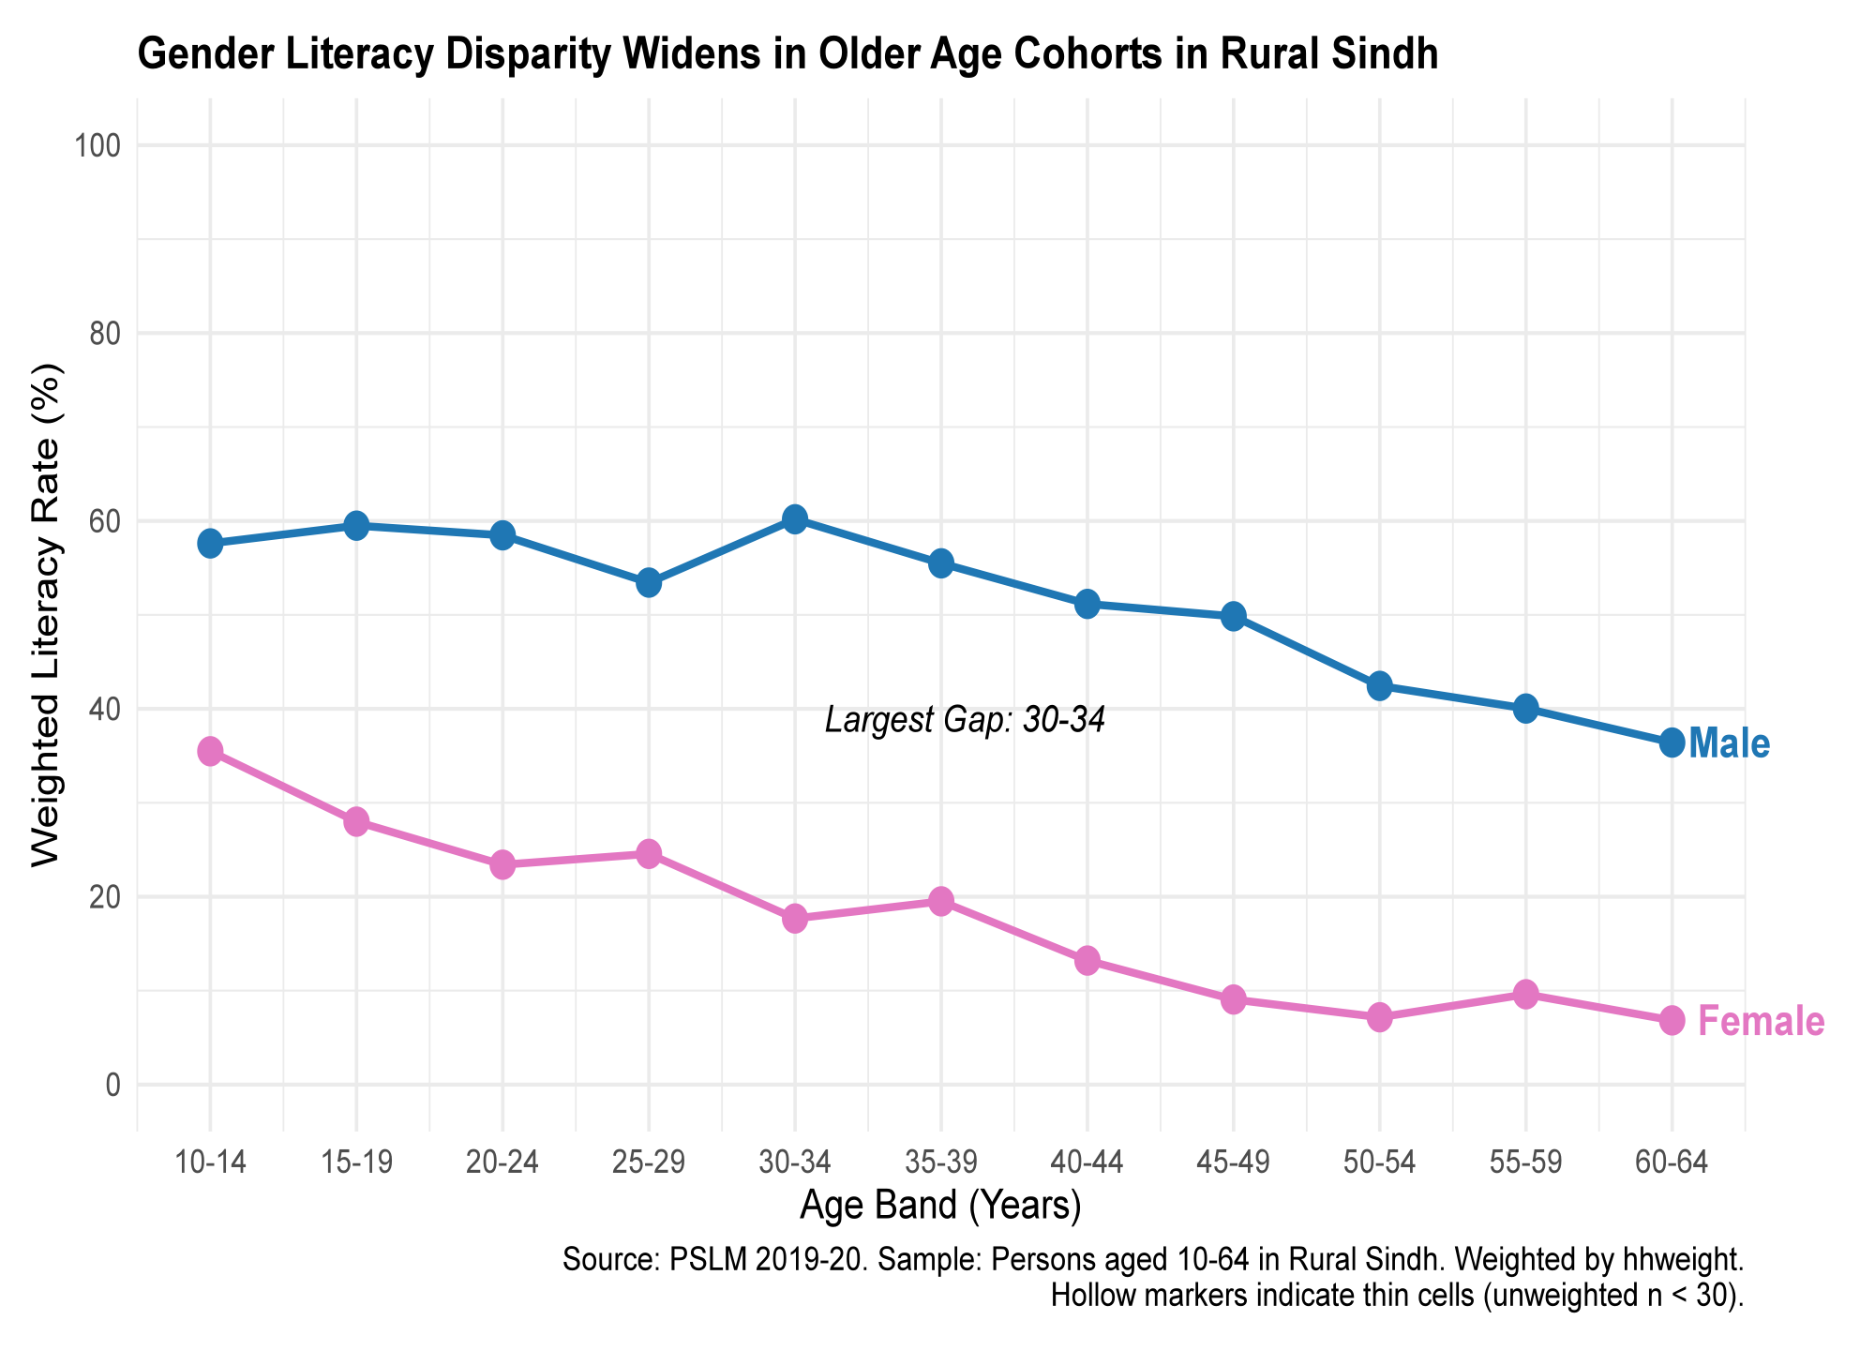
Default Vs Redeign

Slide 3
QUESTION 2
Education Spending Distribution
N = 3,186 Students
Weighted Median Spending
Rs 1,500
Right Skewed Distribution
Unweighted median: Rs 1,500
Spending is heavily skewed toward low amounts for basic schooling, with a thin tail of high-expenditure households.
90/10 Percentile Ratio
18.57×
Survey Weights Function
P10: Rs 350 | P90: Rs 6,500
Applying adjusts for household selection probabilities to represent the entire population accurately.
Excluded Outliers
31 Students

Slide 4
QUESTION 3
Age-Literacy & Gender Profile
Peak Gender Gap: 25–29 Band
Youth Cohort (Ages 15–19)
Cohort Expansion Effect
Male: 61.6%
Female: 28.0%
Younger generations exhibit higher literacy, reflecting expanded access to schooling over recent decades.
Older Cohort (Ages 55–59)
Analytical Limitation
Male: 41.2%
Female: 9.6%
Cross-sectional data cannot separate aging effects within individuals from generational schooling improvements.

Slide 5



QUESTIONS 4 & 5
Makeover & Cross-Language Parity
R & Python Output Parity: 28.0%
1. Aggregated Means
2. High Data-Ink Ratio
3. Environment Tuning
Replaced raw binary points with weighted conditional averages to eliminate heavy overplotting.
Encoded trends with continuous lines, distinct gender colors, and hollow points for thin cells (N < 30).
Explicitly configured Matplotlib grids and margins to match R ggplot2 aesthetics.

